Slide 1
GEMINI Aurora Input Function Overview
A description of gemscr.functions.aurora.m

Slide 2
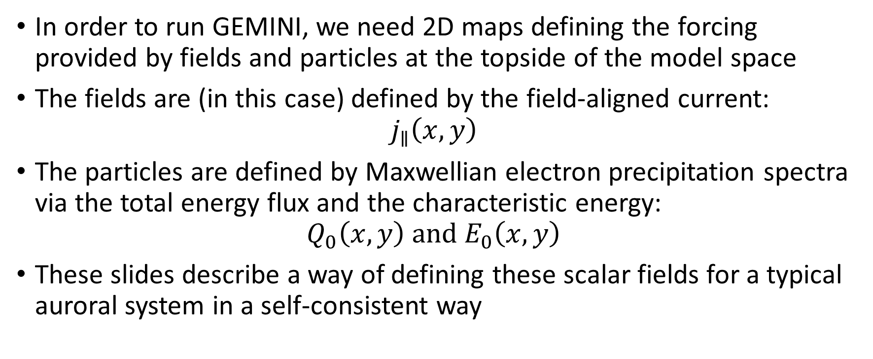
Purpose
In order to run GEMINI, we need 2D maps defining the forcing provided by fields and particles at the topside of the model space
The fields are (in this case) defined by the field-aligned current:
$$j_{∥}\left(x,y\right)$$
The particles are defined by Maxwellian electron precipitation spectra via the total energy flux and the characteristic energy:
$$Q_{0}\left(x,y\right) and E_{0}\left(x,y\right)$$
These slides describe a way of defining these scalar fields for a typical auroral system in a self-consistent way

Slide 3
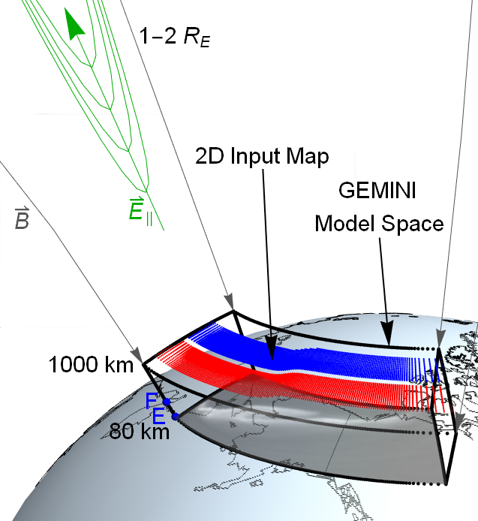

Slide 4
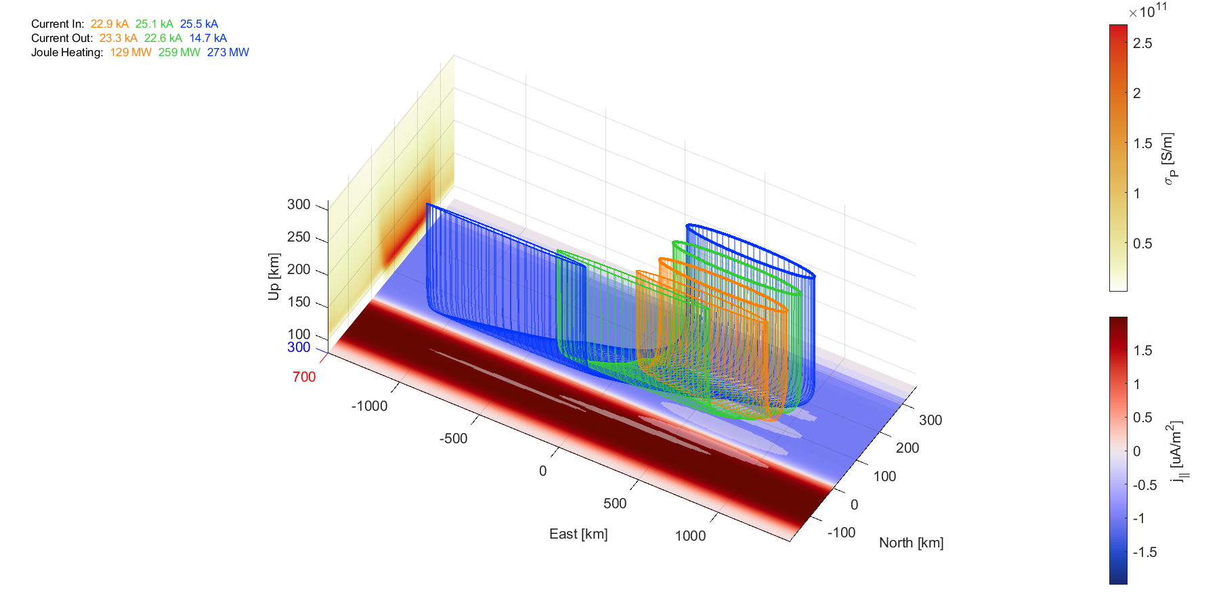

Slide 5
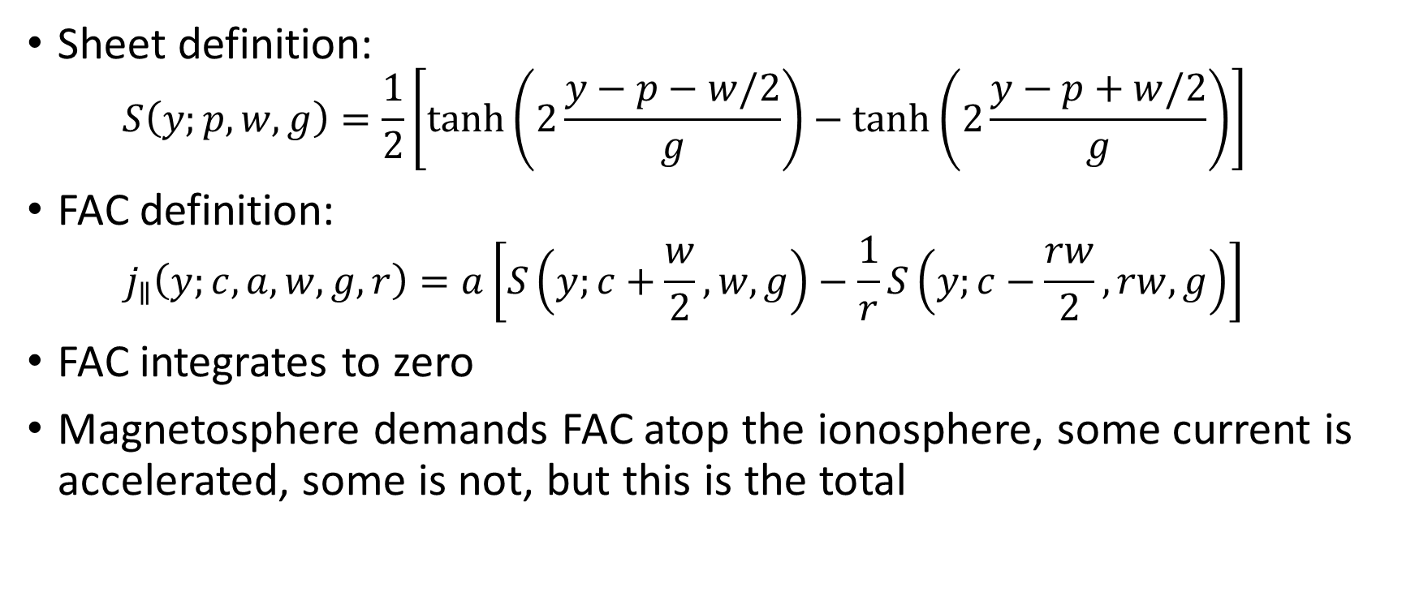
Latitudinal Cuts
Sheet definition:
$$S\left(y;p,w,g\right)=\frac{1}{2}\left[\tanh\left(2\frac{y−p−w/2}{g}\right)−\tanh\left(2\frac{y−p+w/2}{g}\right)\right]$$
FAC definition:
$$j_{∥}\left(y;c,a,w,g,r\right)=a\left[S\left(y;c+\frac{w}{2},w,g\right)−\frac{1}{r}S\left(y;c−\frac{rw}{2},rw,g\right)\right]$$
FAC integrates to zero
Magnetosphere demands FAC atop the ionosphere, some current is accelerated, some is not, but this is the total

Slide 6
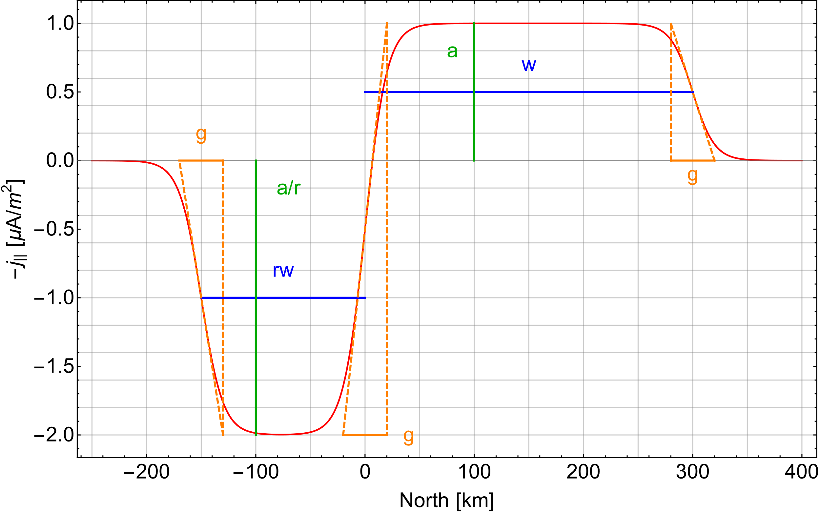

Slide 7
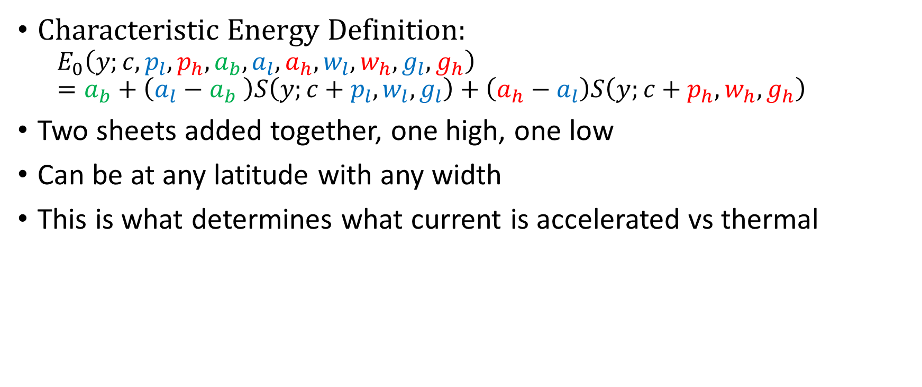
Latitudinal Cuts
Characteristic Energy Definition:
$$E_{0}\left(y;c,p_{l},p_{h},a_{b},a_{l},a_{h},w_{l},w_{h},g_{l},g_{h}\right)=a_{b}+\left(a_{l}−a_{b} \right)S\left(y;c+p_{l},w_{l},g_{l}\right)+\left(a_{h}−a_{l}\right)S\left(y;c+p_{h},w_{h},g_{h}\right)$$
Two sheets added together, one high, one low
Can be at any latitude with any width
This is what determines what current is accelerated vs thermal

Slide 8
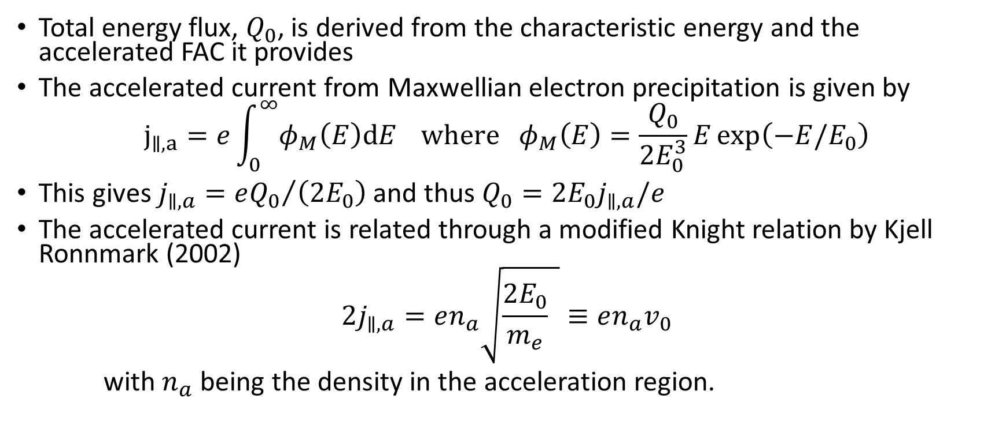
Latitudinal Cuts
Total energy flux, $Q_{0}$, is derived from the characteristic energy and the accelerated FAC it provides
The accelerated current from Maxwellian electron precipitation is given by
$$j_{∥,a}=e\int_{0}^{∞}{φ_{M}\left(E\right)dE} where φ_{M}\left(E\right)=\frac{Q_{0}}{2E_{0}^{3}}E\exp\left(−E/E_{0}\right)$$
This gives $j_{∥,a}={eQ_{0}}/{\left(2E_{0}\right)}$ and thus $Q_{0}=2E_{0}j_{∥,a}/e$
The accelerated current is related through a modified Knight relation by Kjell Ronnmark (2002)
$$2j_{∥,a}=en_{a}\sqrt{\frac{{2E}_{0}}{m_{e}} }≡en_{a}v_{0}$$
with $n_{a}$ being the density in the acceleration region.

Slide 9
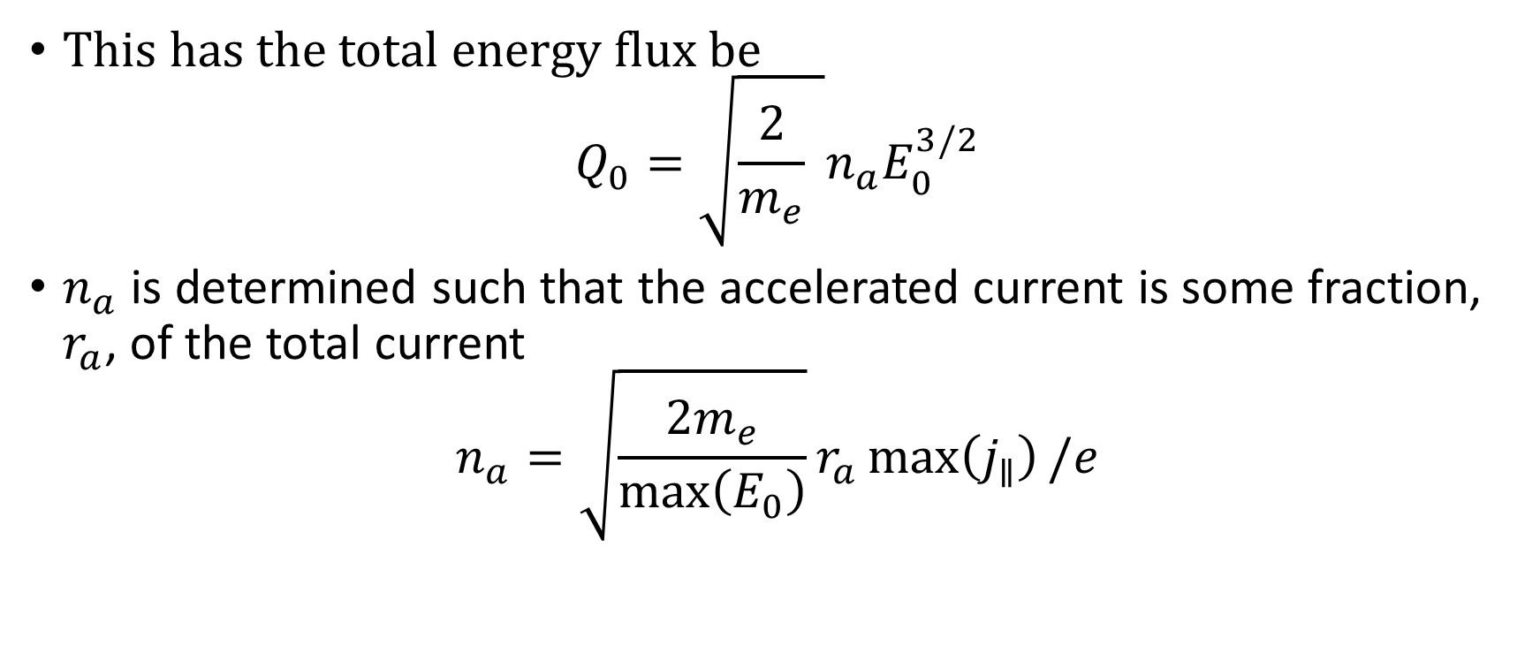
Latitudinal Cuts
This has the total energy flux be
$$Q_{0}=\sqrt{\frac{2}{m_{e}} }n_{a}E_{0}^{3/2}$$
$n_{a}$ is determined such that the accelerated current is some fraction, $r_{a}$, of the total current
$$n_{a}=\sqrt{\frac{2m_{e}}{\max\left(E_{0}\right)}}r_{a}\max\left(j_{∥}\right)/e$$

Slide 10
